Slide 1



Stop Selling.
Start Solving.
Four common CX problems and how to solve them with SuccessKPI
Dave Rennyson
CEO & President
SuccessKPI

Slide 2


















SuccessKPI Fundamentals
Global and
Scalable SaaS
Pure multi-tenant SaaS deployed globally in minutes. Scalable to 20, 2000, or 20,000 agents.
Easy
to Use
GenAI-powered for enterprise business users—no Ph.D. required
GenAI at
Work on Data
A unified and governed data lake house powers GenAI across all WEM layers.
Insights Drive Action
Patent-pending Playbook Builder™ delivers action real-time agent assistance, alerts & automation.
Built-In Security
A rigorous security profile managed for you supported by 3rd party validation

Slide 3
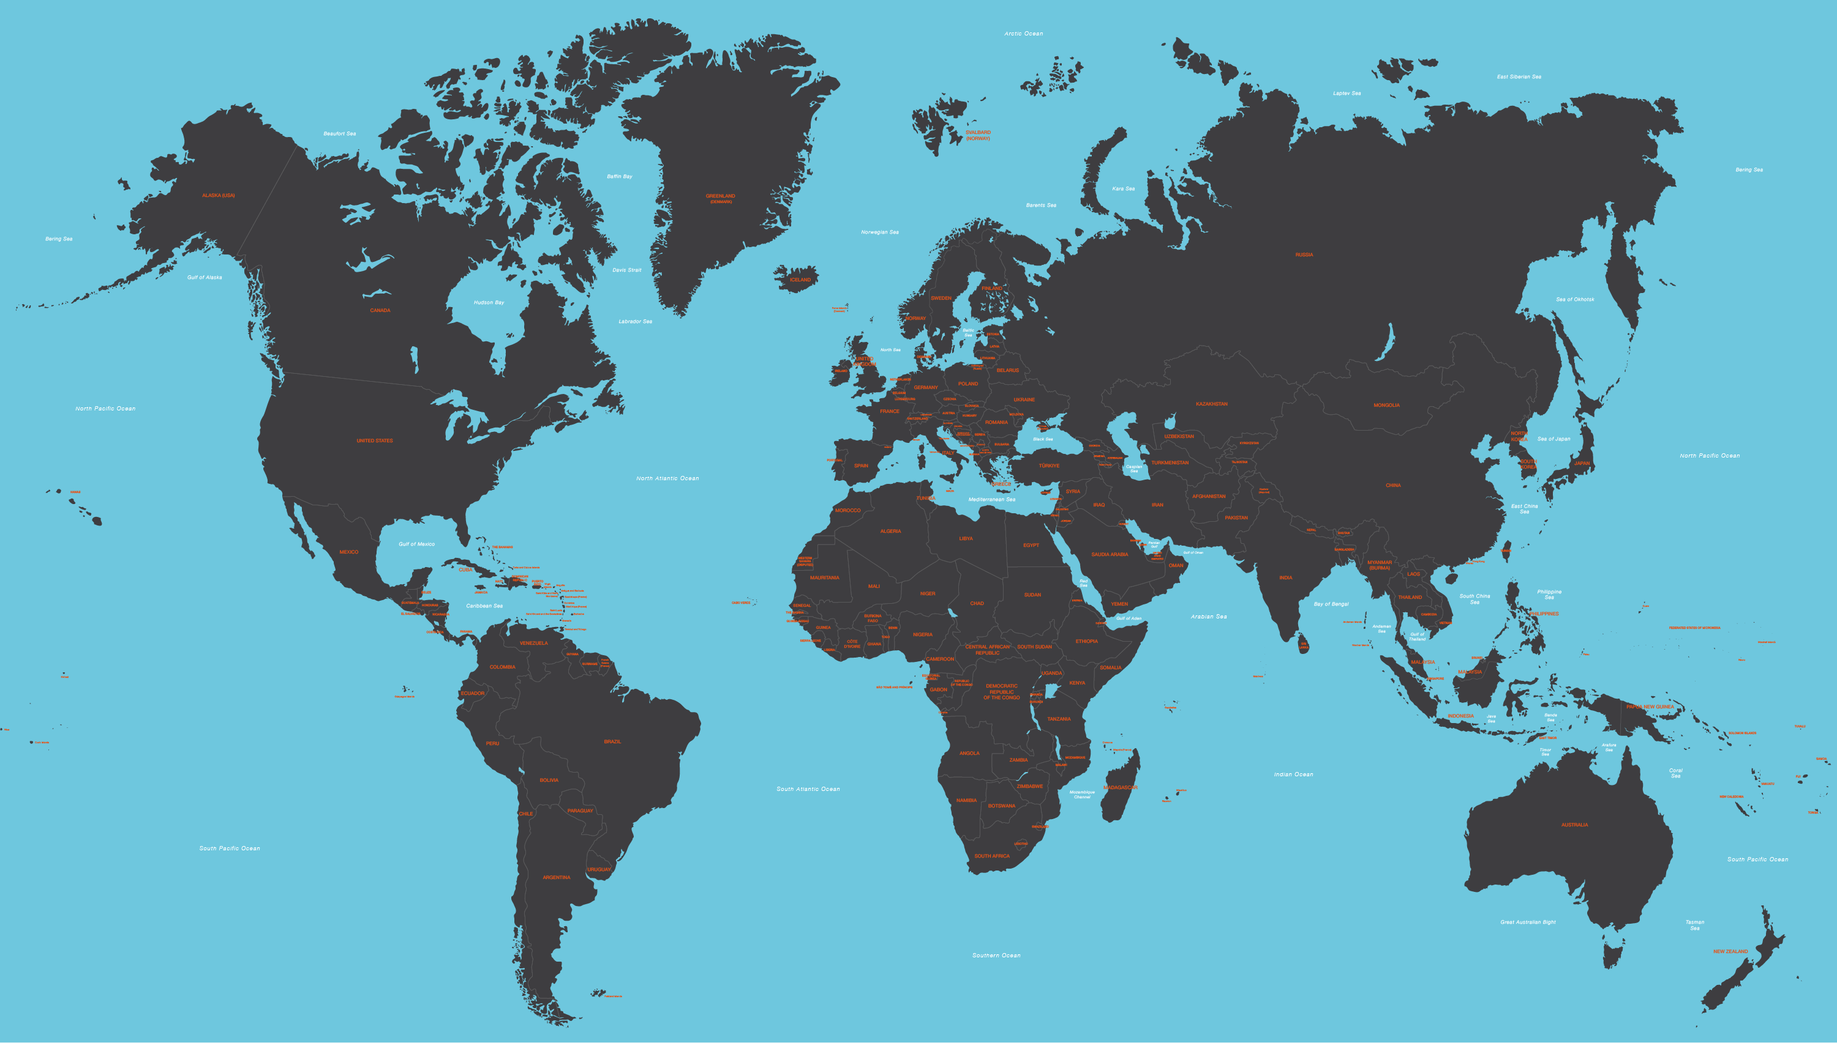
SuccessKPI – Who We Are
Snapshot
200+
Territories where we have customers
>20,000
agents within many customers
14
Countries where employees are based
24/7
Support coverage for your customers
Q2
Teams
Datacenters

Slide 4

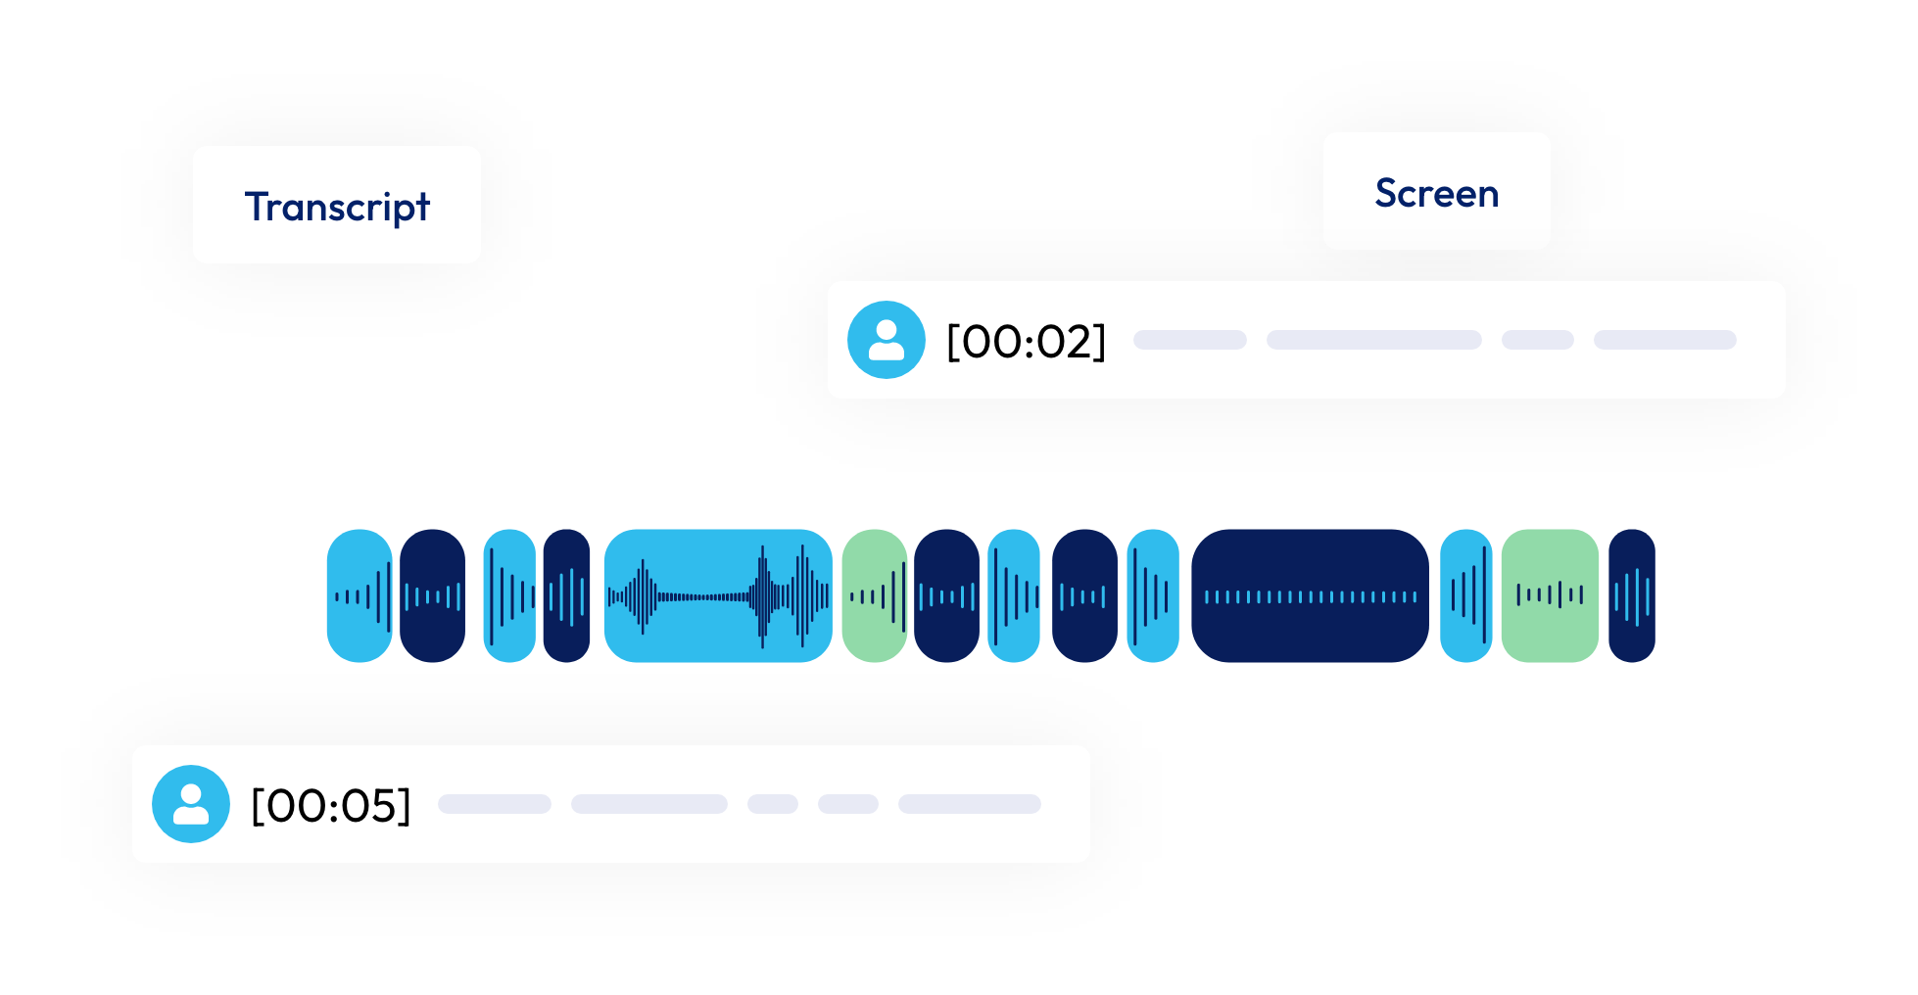
Delivering Differentiated Value to Alvaria
Unify
Reveal
Assist
Act
Refine
Playbook Builder
Analytics/BI
WFM
Speech
& Text
GenAI
Quality Monitoring
Agent
Assist
Recordings and transcripts
Integrations
CRM and Bus. Applications
CCaaS Metadata
Data Lakehouse - AI Framework – Security
No Code Serverless Cloud Architecture

Slide 5


Why we are here
Your Customers Need a Value and innovation Plan
Divestiture, Renewals, Platform transitions, Product and programmatic displacements, Innovation
Your Prospects Need Acceleration
A new command center, fully integrated with Alvaria, to
drive better CX, reducing risk and accelerating adoption
Automated Quality Management and Speech Analytics
Existing QM scorecards are difficult and don’t cover all agent work and miss regulatory indicators
AI WFM integrated with Alvaria CX
Traditional WFM or spreadsheets is not getting it done. Provide a new AI WFM with key features.
Single Source of Action
Need for total operating system, powered by AI, to compile data and improve outbound contact center performance
Agent Observability & Last Mile
Quality of the agent environment is negatively impacting the customer

Slide 6

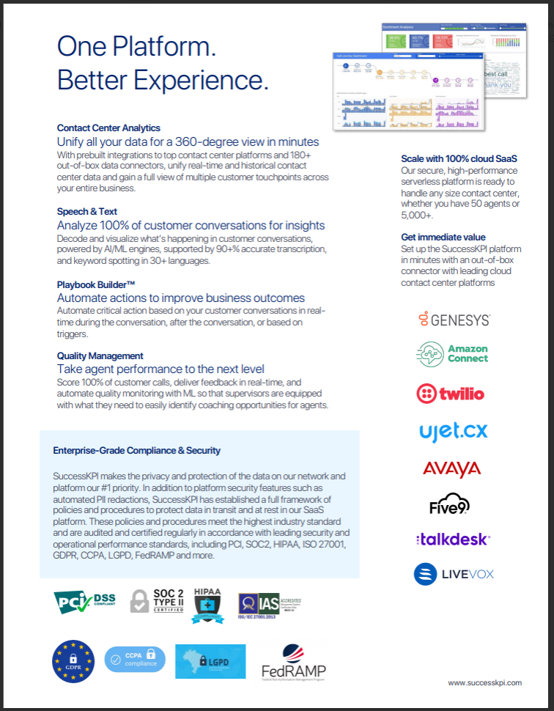


What we’ll provide, enabling you to sell more
Partner
Portal
For each Alvaria Powered by SuccessKPI solution
Problem | Quick Questions to Qualify | What’s the ICP | Alvaria powered by SuccessKPI Solution & Impact
Manual QA Too little & limited to a small % of calls QM forms are difficult and don’t cover all agent work Regulatory exposure | What percent of interactions are reviewed today? How long does it take for QA insights to turn into coaching? Is QA scoring consistent across supervisors, or does it depend who reviews it? Do you have dedicated or ad hoc QM Agents? | Less than or about 2% QA coverage today Regulated industries (insurance, banking, healthcare, government, pharmaceutical) Large supervisor teams High need for compliance & coaching impact | AutoQM / Unified Quality Monitoring Automates QA for 100% of interactions with AI-driven scoring, heatmaps and targeted coaching insights. Impact: Improve quality scores, increase coaching, supervisors reclaim time Manual, Automated, and Hybrid (Calibrated)

Slide 7
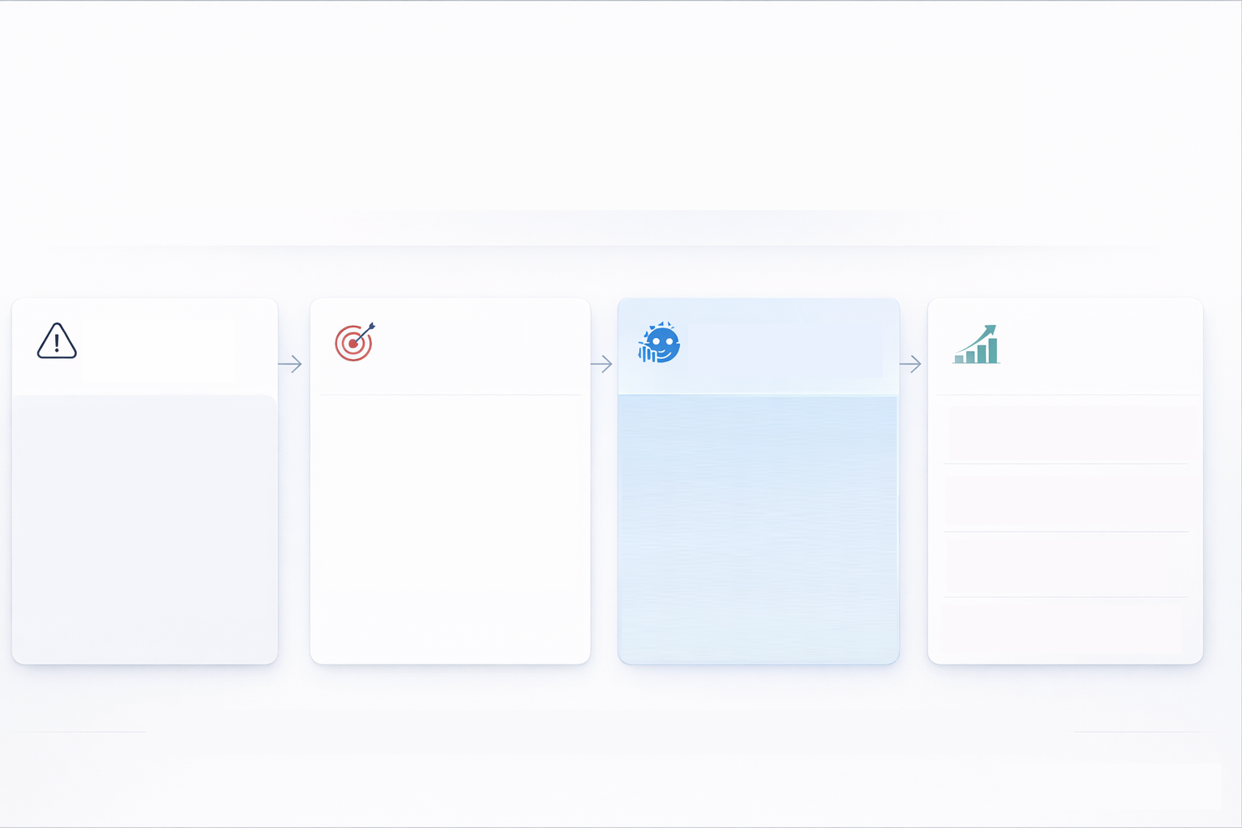
1. AI-Driven Quality Intelligence:
Scale quality, collections and compliance with GenAI Powered Automation
Challenge: Limited QA Visibility
Solution: Eliminate Blind Spots
How: SuccessKPI
AI Quality Mgmt
Results: Measurable Business Impact
10%
30-50%
2-3x
15-25%
Overall Performance Improvement
Manual QA reviews only ~1% of calls
Compliance risk
Vulnerable customer signals and broken scripts
Agent friction that impacts debt recovery rates
Eliminate blind spots in outbound collections
Ensure compliance, empathy in customer interactions
Optimize for recovery performance
Automated QM + Speech Analytics and Playbooks
100% Call Evaluation
Automated Compliance Scoring (ex. FDCPA, vulnerability)
Real-time friction detection and performance insights
Reduction in Regulatory Costs
Coaching Effectiveness
Dispute-driven Leakage
1% Sampling
100% AI Intelligence
Revenue & Risk Improvement

Slide 9
2. AI Powered WFM:
Delivering optimized outcomes with efficient workforce
Challenge: Current WFM Ineffective
Solution: Maximize Agent Effectiveness
How: SuccessKPI
Integrated WFM
Results: Measurable Business Impact
5-15%
3-7%
8-12%
0x
Increase yield per labor dollar
Missed Recovery due to over/under-staffing
Agent burnout/turnover
Low connect rates and declining productivity
CSAT levels decreasing
Align right number of agents
Staff delinquency segments more efficiently
Maximize recovery yield
Better agent flexibility and satisfaction
WFM integrated with multiple channels
Leverages performance data, recovery trends, interaction analytics
Forecasts optimized staffing needs around high-value windows
Reduction in shrinkage
Increase in campaign penetration
FTE growth while improving efficiency
Old Employee Mgmt
Integrated WFM
Improved Agent Satisfaction

Slide 10
3. Disconnected Tools:
Unpack data disparity by delivering a unified Operating System for Outbound
Challenge: Systems and data disconnect
Solution: Unified Performance View
How: SuccessKPI
Operating System
Results: Measurable Business Impact
5-10%
6%
8-12%
0x
Disconnected systems, lack of full view
Data spread between QA, dialer, WFM, CRM
Difficult to link agent behavior and recovery times
All channels and systems flow to central data repository
Connect compliance, agent behavior, process metrics
Solve for operational friction and financial recovery
Consolidates interaction analytics
QA, WFM, dialer, CRM and more flow to unified BI dashboards
Links agent activity directly to recovery KPIs
Revenue lift
Reduction in Leakage
Increase in campaign penetration
FTE growth while improving efficiency
Old Employee Mgmt
Single pain of glass
Improved CC Performance

Slide 11
4. Agent last mile observability
Turn Chaos into Clarity with End User Optimization
Challenge: Unaware agent intelligence
Solution: Maximize Agent Effectiveness
How: SuccessKPI
Last Mile
Results: Measurable Business Impact
Limited visibility into agent devices, networks, and home environments
Technology issues often mistaken for performance or coaching problems
Slow, reactive troubleshooting impacts live outbound conversations
Understand the real agent experience during interactions
Prevent disruption before customers are impacted
Create stable conversations that support successful payment outcomes
Monitors agent endpoint performance including device, network, and audio quality
Provides real-time visibility into interaction-impacting issues
Connects technology performance to agent productivity and outcomes
45-75
5-10%
12-20%
0%
Minutes of agent productivity recovered per day
Increase in payment capture velocity
Reduction in
non-talk time
Increase in headcount due to outbound throughput
Disparate agent quality
Holistic workforce approach
Improved Agent Quality

Slide 12


Global customers and outcomes that we deliver
20,000 agents across 250 contact centers
Unified Command Center transformed managing compliance in weeks and months
Tight integration with multiple CCaaS platforms
Operational impact driving $8.8M. In annual improvement
>$50m revenue opportunity
Massive cloud migration 25k agents across 200 countries
Streamlined delivery process
Build a “gold standard” analytics framework
Strong executive alignment around Tiger team
Now moving to GenAI powered analytics to generate cross and upsell opportunities for insurance products
Began with reporting migration and extract DBaaS
Became "Trusted partner”
Aligned to IHG top priorities for automated Quality Management
One of 10 customer contact centers for citizens (FEMA, CDC, DoE, DoS, USPS, and NYSOH.)
Full spectrum solutions deployed in multiple modes
Recent success driving “Top 5 Problem/ Identification and resolution cycles
Established framework for analytics for top customer (Royal Caribbean) using GenAI to drive fast insights into sales and conversion rates
Developed Auto QM Use Case which is now being planned for rollout as BPO standard. Early signs accuracy >90% compared to human agents
Notes:
IHG: Arabic GenAI story
C: command center
VES: power pack
DHL: customize
GenAI success story / need

Slide 13
Solve CX Problems with Alvaria powered by SuccessKPI
Problem | Quick Questions to Qualify | Great Fit Customer | Alvaria powered by SuccessKPI Solution & Impact
Manual QA too slow & limited to a small percentage of calls. QM scorecards are difficult and don’t cover all agent work. | What percent of interactions are reviewed today? How long does it take for QA insights to turn into coaching? Is QA scoring consistent across supervisors, or does it depend who reviews it? Do you have dedicated or ad hoc QM Agents? | Less than or about 5% QA coverage today Regulated industries (insurance, banking, healthcare, government, pharmaceutical) Large supervisor teams High need for compliance & coaching impact | AutoQM / Unified Quality Monitoring Automates QA for 100% of interactions with AI-driven scoring, heatmaps and targeted coaching insights. Impact: Improve quality scores, increase coaching, supervisors reclaim time
Traditional WFM not getting it done. Provide AI WFM with key features, fully integrated with Alvaria CX. | When CX metrics shift, how do you uncover the root cause today? How long does it take to test a hypothesis and confirm if a change worked? If you could validate improvements in days vs. months, what would you fix first? | Leaders who can’t answer why performance changed Overstaffing or visible issues with Average time to pick-up Need fast, evidence-based decisions Executive pressure to prove AI/CX ROI | AI-infused workforce management Helps teams form , analyze patterns, and validate what actually drives improvement. Impact: Finds root causes quickly, put insights to action
Too many tools, no single source of truth. Lack of total operating system to manage outbound contact center performance. | How much time do leaders spend reconciling data across systems today? What is the financial or compliance risk of delayed issue detection? If everyone saw the same real-time truth, what decisions could move faster? | 500+ agent contact centers Multiple CCaaS / WFM / QM / CRM / ticketing tools Multi-site or multi-client BPOs Need for real-time CX performance dashboards | Unified Command Center Combines performance, quality and AI insights into a “single pane of glass” for real-time visibility and action. Impact: Fewer escalations, operational savings, single source of truth
Agent Observability & Last Mile. CX breaks at the agent edge (remote/hybrid). | How do you spot remote agent issues before customers complain? Who actually sees the root cause when calls fail? Do these issues keep recurring? | At least 30% remote/hybrid agents BPOs with distributed workforces BYOD or varied home networks Inconsistent CX tied to remote agents | Last-mile Monitoring Real-time visibility into agent desktop, network and headset performance so issues are detected and fixed before they impact CX. Impact: Reduce troubleshooting time, improve CX

Slide 14

What comes next? Alvaria Enablement Bootcamp
Workshop 1
Workshop 2
Workshop 3
Workshop 4
Workshop 5
Platform Overview &
Data Architecture
Speech & Text
Analytics
Action Framework &
Playbook Builder
Quality Monitoring
& Evaluations
Building a KPI Command Center
8-step problem methodology
Unified data lake architecture
Go-to-market positioning
BI & reporting library
Topics & keyword detection
Themes & conversation scoring
Sentiment analysis
Generative AI Deep Prompts
Playbook differentiator
Conditions, triggers, actions
No-action discovery playbooks
AWS Lambda integrations
Evaluation forms & scoring
Auto-QM capabilities
Evaluation workspace workflow
Coaching integration
Dashboard design principles
Data set selection & blending
Customer-facing analytics
Command center views

Slide 15
Thank you

